Slide 1
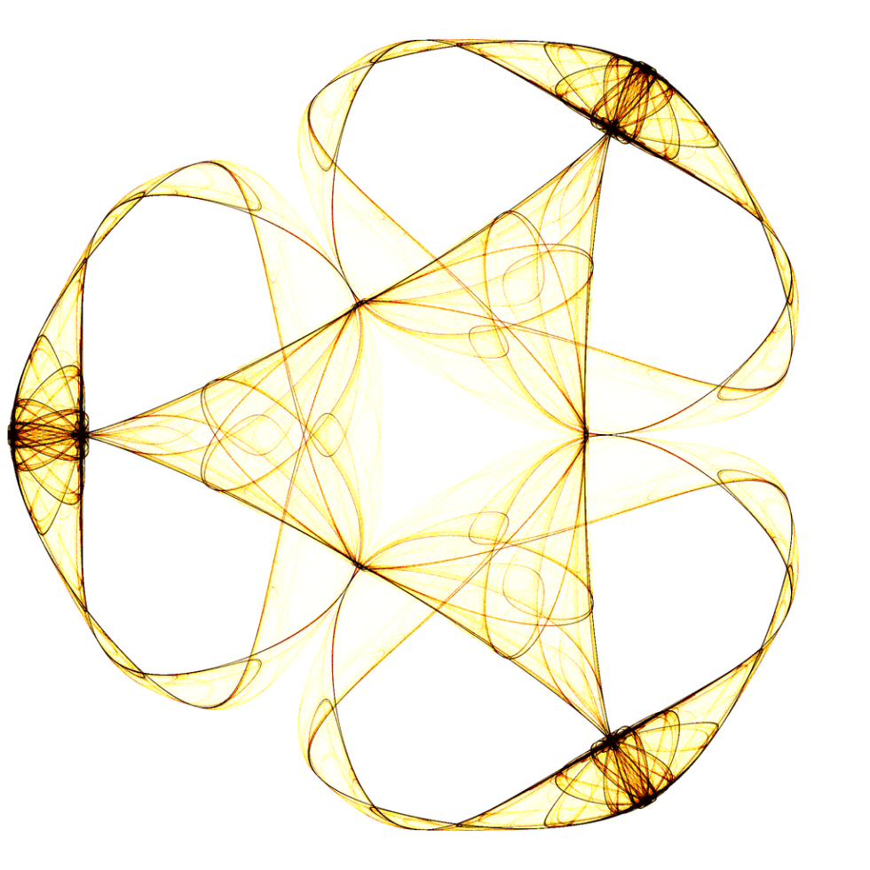
CMOS Camera Design
Final Project
Presented by
Yaniv Fais
Lior Shoval
Dan Eidelman

Slide 2
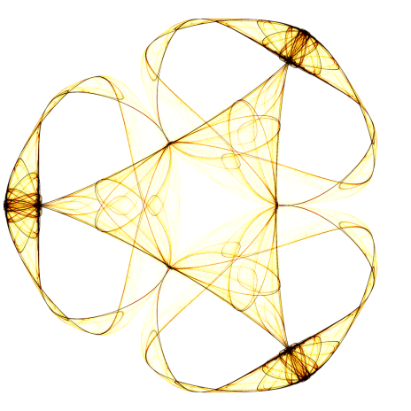
Presentation Overview
Process overview
Image acquisition and Semiconductor calculations
frontend ISP
Generic ISP and Noise correction
References

Slide 3
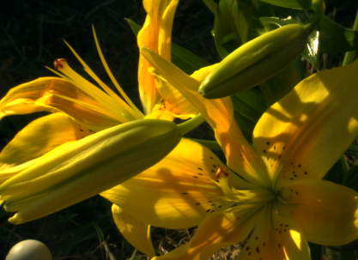
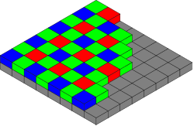
Process overview
10 bit Analog to Digital
Front-End ISP : correct row noise
Front-End ISP : correct hot pixel (Blind Defect) using ranged limit approach with 5x5 support
Demosaicing using GCB liniearization method
Bayer Proc ISP : Noise remove using Bilateral Filter
Gamma correction of RGB
Color correction and white balancing using preset values from Macbeth
Post process – saving to JPEG file / showing in display

Slide 4
Image Acquisition and Semiconductor calculations

Slide 5
Image Acquisition
reflectance at each pixel is given values in milliwatts per steradian per square metre per nanometer
  Integrate over all frequencies
  Multiply by POV of each pixel (65deg -> multiply by 1SR)
  Multiply by the active area of the pixel

Slide 6
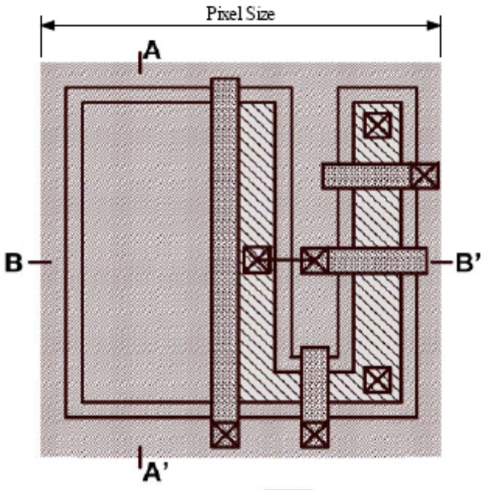

Semiconductor calculations
Pixel active area
Active
Area

Slide 7


Semiconductor calculations
Continued
Full well capacity
Error figures

Slide 8




Semiconductor calculations
Continued
Voltage calculation
Floating diffusion Capacity
Area
FD

Slide 9


Semiconductor calculations
Continued
Voltage calculation
Q is a function of photon currant and dark currant

Slide 10
Frontend ISP

Slide 11
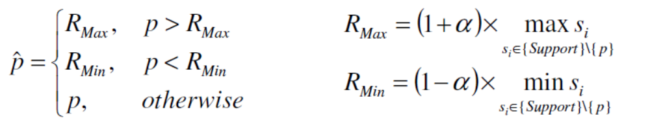
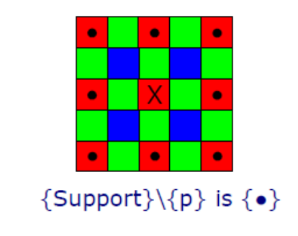
Frontend ISP
Blind Defect correction of hot pixels
Ranged limit approach over a 5x5 support with α = 0.15 (selected using empirical results)

Slide 12
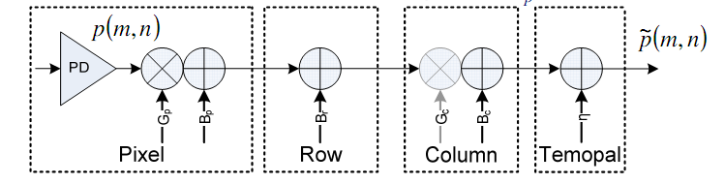
Frontend ISP
Row noise correction
After modeling pixel response and plugging in real world assumptions, we are left with the below model. Each pixel has its own gain and offset behavior. Then, all pixels from same row are modeled by an additive offset (neglecting gain level which is very close to 1 – timing is quite accurate) and then all columns are modeled by another additive offset (closed loop gain variations are negligible – open loop gain is very high). Finally a temporal noise component is added.

Slide 13
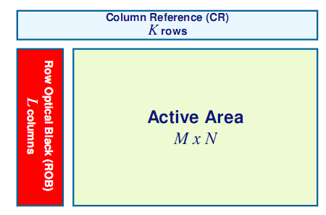

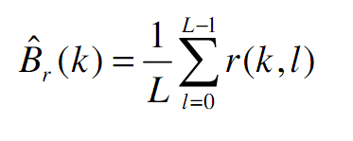
Frontend ISP
Row noise corrections - continued
In order to improve row noise estimation and correction, Row Optical Black (ROB) columns are added to sensor array.
Those optical black (OB) pixels are real black pixels experience exactly same noise as active pixel throughout the entire reset/exposure cycle. Nevertheless, dark current of OB pixels and hot pixels affect the estimation quality.
Since these are optically black pixels Gp is irrelevant. Row noise correction is performed after CFPN correction so most of the CFPN noise is cancelled except for remaining error (estimation noise). Thus, we are left with:
Finally, the row per noise is estimated by averaging each OB row:
In fact, this stage estimates also the black noise of the sensor.

Slide 14
Generic ISP

Slide 15
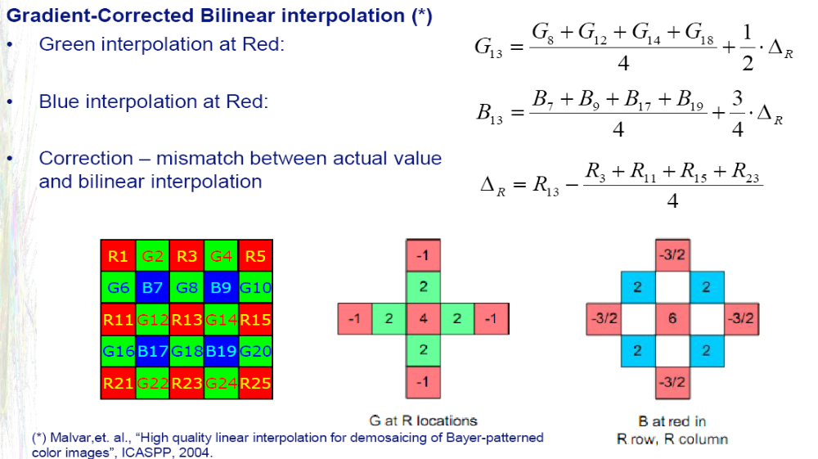
Generic ISP
Demosaicing using GCB method (*) (1)
applying the following filter to the Bayer array to get the RGB matrix
the Bayer array is padded with two additional indices which are copy of the two neighboring rows/columns

Slide 16
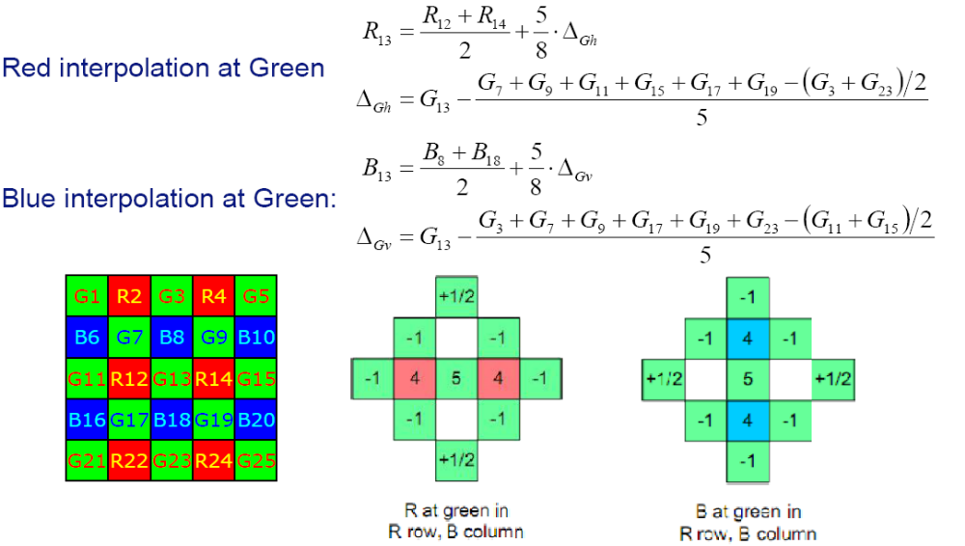
Generic ISP
Demosaicing using GCB method (2)

Slide 17
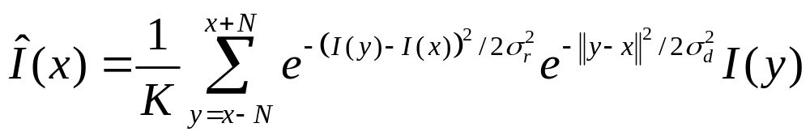
Generic ISP
Noise reduction
In order to remove readout noise and additional additive noises we are using the Bilateral filter, the parameters σ_{d} , σ_{r} used after empirical results.
The bilateral filter employs this computation over the 2D matrix where K is computed as normalized over all weights.
    As this filter is apparently highly compute intensive it was implemented using C inside Matlab MEX interface.
    It should also be noted we've tried the Matlab intrinsic wiener filter however the Bilateral filter seem to produce better results

Slide 18
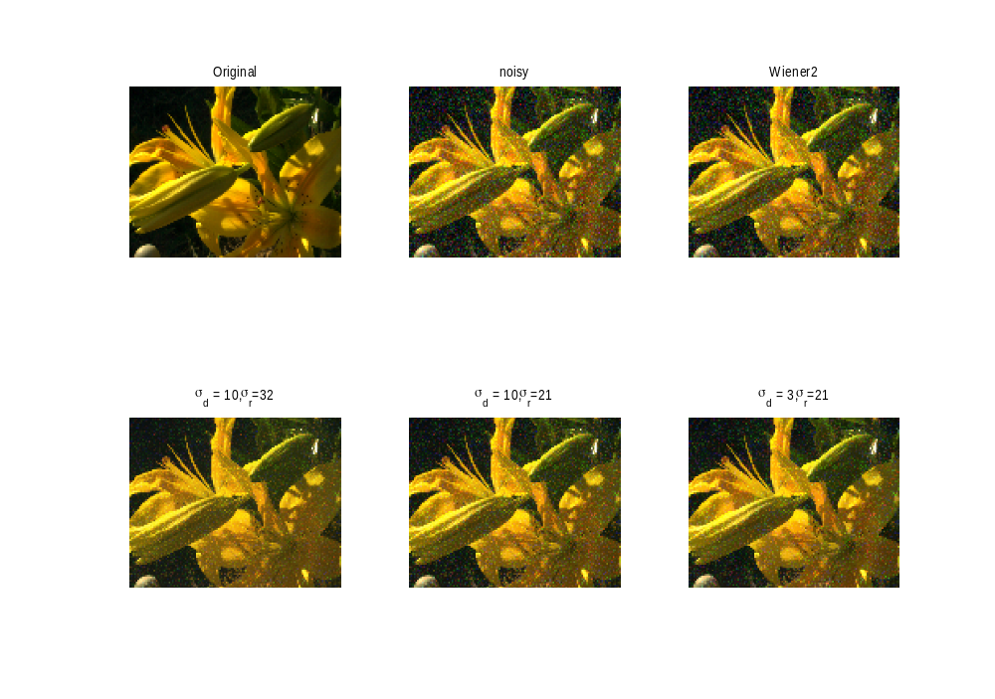
Generic ISP
Noise reduction filters test

Slide 19
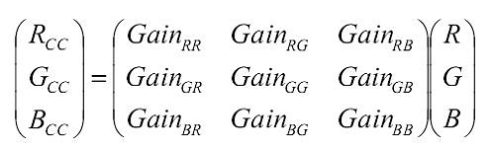
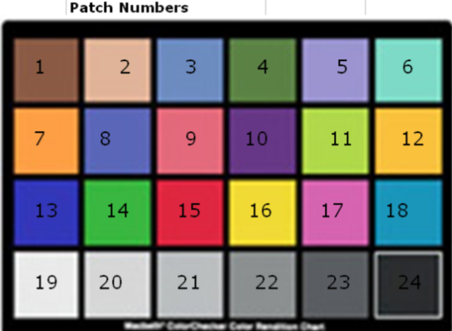
Generic ISP
Color Correction
Sensor CFA response is different from the ideal color response, thus one should compensate for this difference.
The three components (R, G, B) are adjusted by gains allocation per color.
The process of color correction was using the GretagMacbeth color checker. We have downloaded the Spectral Reflectance Factor of Macbeth Color Checker patches. Then, the spectral components were interpolated (decimated) to 33 spectral points (400-720 nm) to match the system input format.

Slide 20
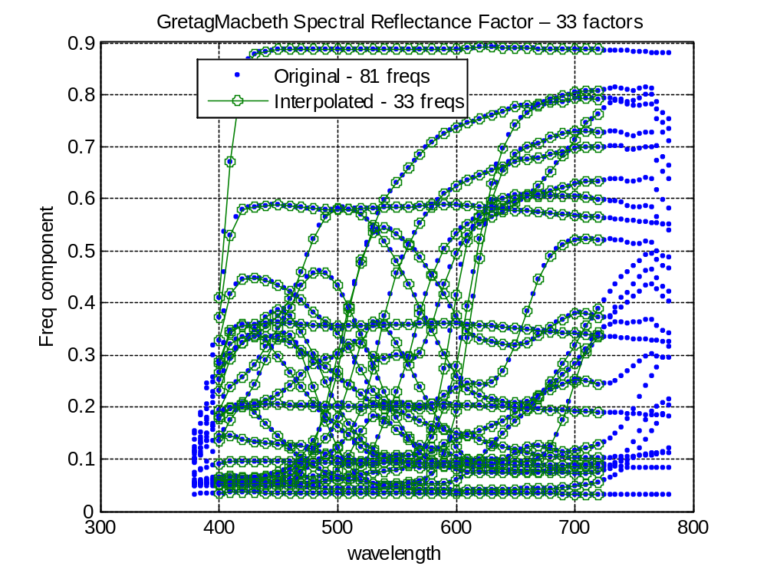
Generic ISP
Color Correction - Continued

Slide 21
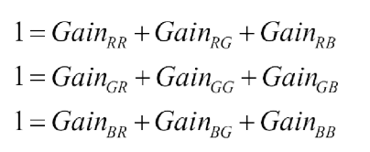
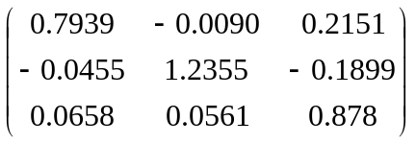
Generic ISP
Color Correction
Next step was to find CCM which minimizes the error between the ideal colors and the corresponding colors after CCM by minimizing RGB MSE by Least Squares (linear).
Also, the Color Correction Matrix (CCM) should keep the gray colors consistency, thus:
Taking account of all the above, resulted with:

Slide 22
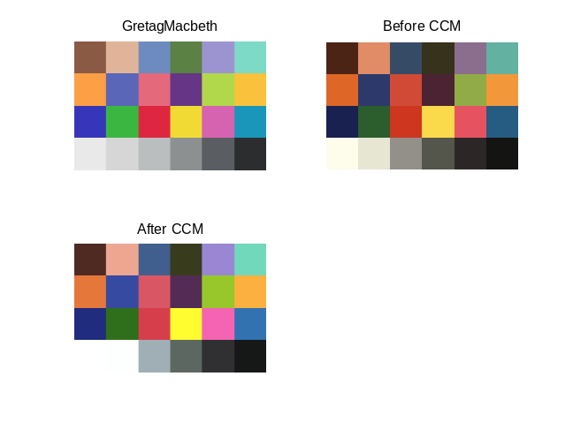
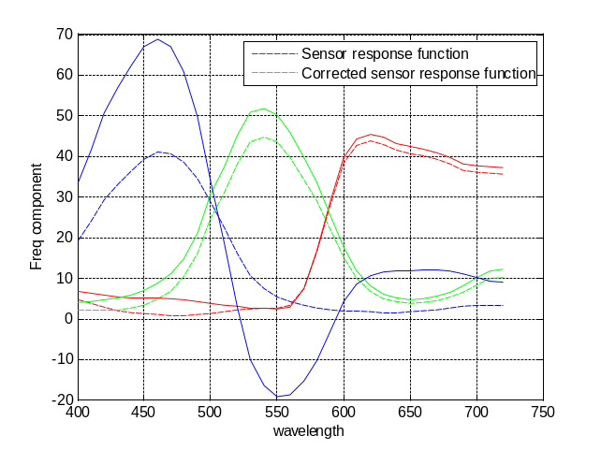
Generic ISP
Color Correction
Taking account of all the above, resulted with:

Slide 23
References
CMOS Image Sensors: Electronic Camera-On-A-Chip, Eric R. Fossum, IEEE TRANSACTIONS ON ELECTRON DEVICES, VOL. 44, NO. 10, OCTOBER 1997
O. Yadid-Pecht and R. Etienne- Cummings, "CMOS imagers: from phototransduction to image processing" , Cluwer Academic Publishers, 2004.
Image Sensors and Signal Processing for Digital Still Cameras, Junichi Nakamura
http://www.andor.com/learning/digital_cameras/?docid=321
Smart CMOS Image Sensors and application , Jon Ohta
Computational Colour Science using MATLAB , Stephen Westland
Digital Image Processing using MatLab , Gonzales
Digital Image Processing , Pearson
An Introduction to Digital Image Processing with Matlab-
Alasdair McAndrew
OpenCV library (opencv.willowgarage.com)
DCRaw (http://en.wikipedia.org/wiki/Dcraw)

